Slide 1
Jermyn Borough Council Meeting
7/15/21

Slide 2
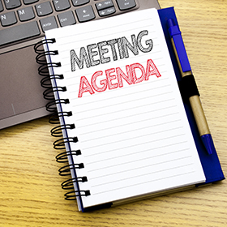
Meeting Agenda
Call to Order
Pledge of Allegiance
Roll Call
Previous Meeting Minutes
Treasurer’s Report/Bills Payable
Correspondence
Public Comment
Professional Reports
Committee Reports
Borough Manager Report
Lackawanna County Land Bank
Local Ordinances & Enforcement Powers
Rental Registration Ordinance Amendment
Pension Assumption Recommendations
Police Coverage
Executive Session – Personnel Matter
New Business
Adjournment

Slide 3
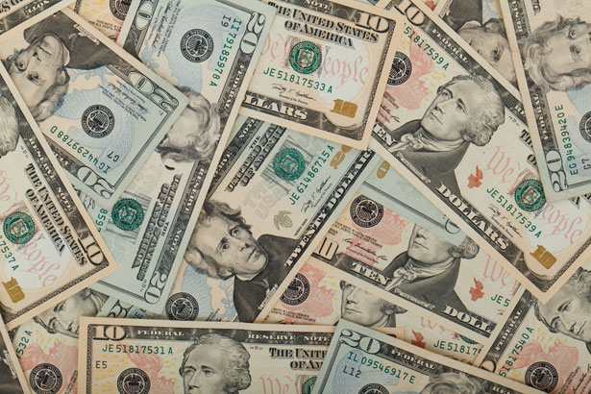
Treasurer’s report
7/15/21
ASSETS
American Rescue Plan Fund 107,442.95
Capital Reserve - DPW 10,513.87
Capital Reserve - Police 4,456.82
Crime Watch Fund 755.44
General Fund - Community 280,380.55
General Fund - FNB 3,095.93

Slide 4
Treasurer’s report
Holiday Lights Fund 550.14
Investment - General Fund 1,001.54
Investment - Liquid Fuels 33,814.61
Investment - Paving Fund 1,011.90
Investment - Recycling 5,003.51
Investment - Refuse 2,600.27
Liquid Fuels - FNB 55,411.00
Petty Cash 153.42
Recreations Fund 12,895.25
Recycling - Community 8,168.01
Refuse Checking - FNB 126,484.37
Total Checking/Savings 653,739.58

Slide 5
Treasurer’s report
Accounts Payable 108,348.48

Slide 6


Slide 7
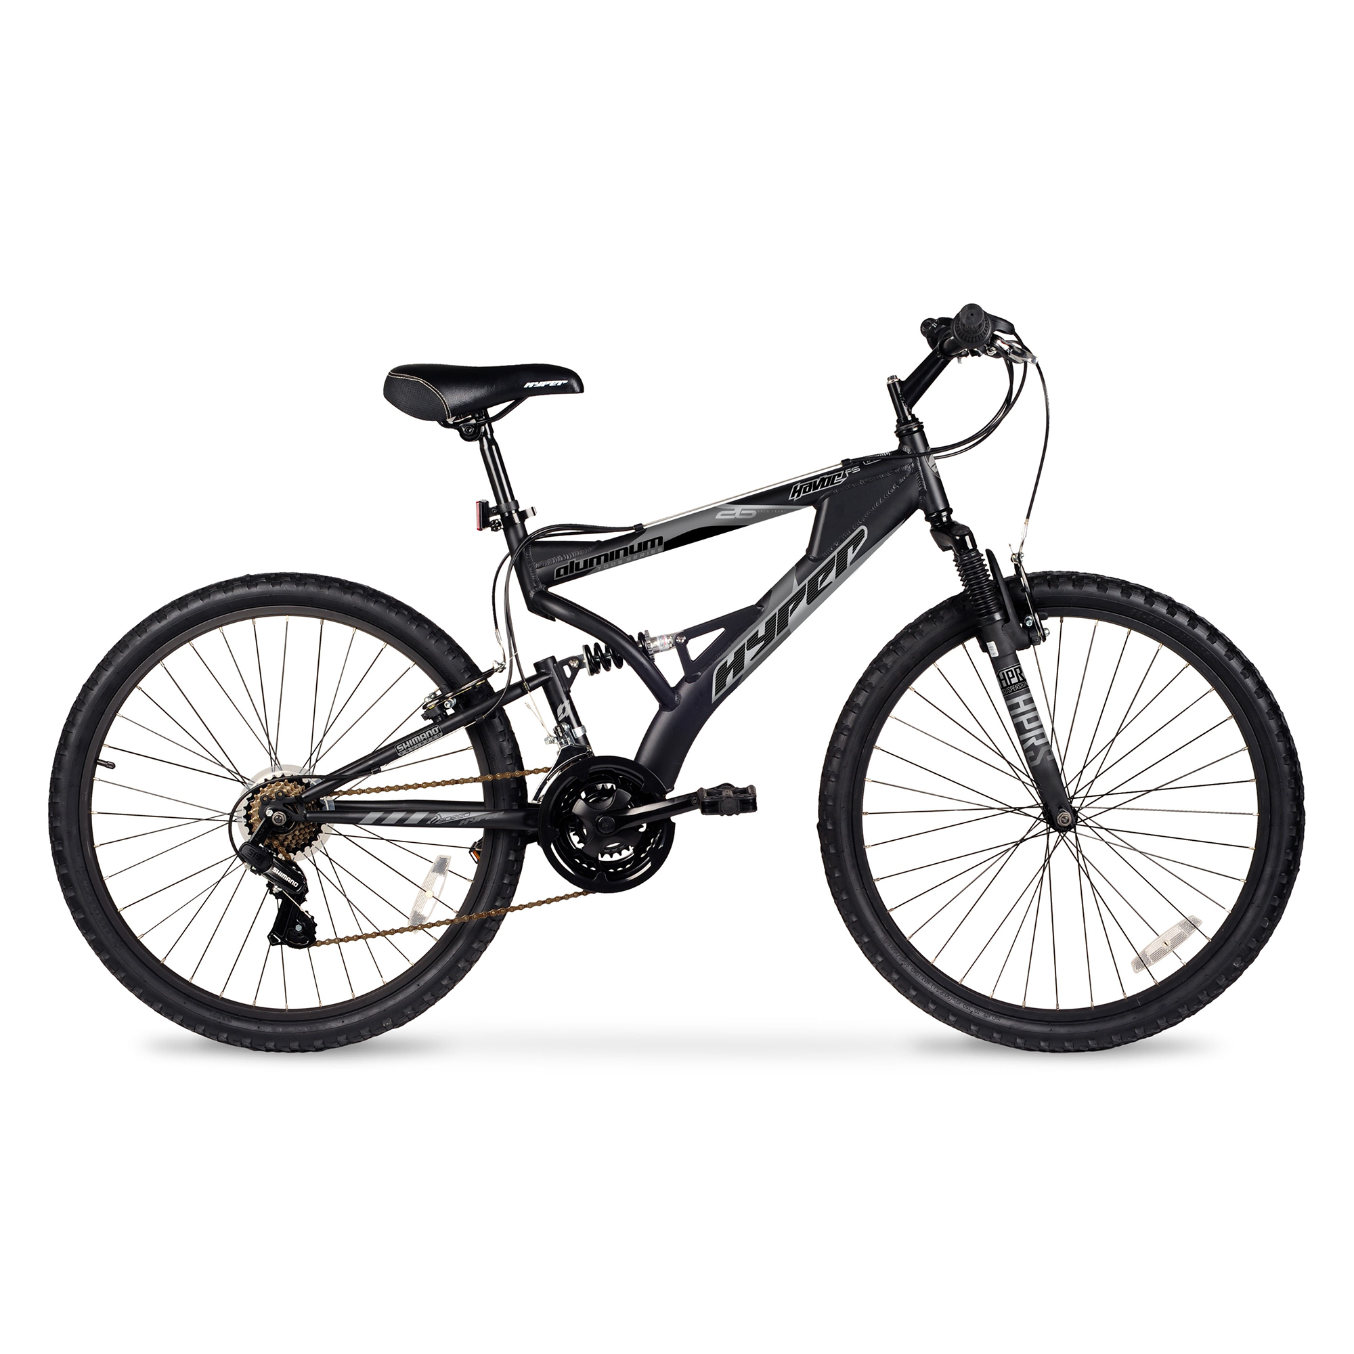

Slide 8


Slide 9
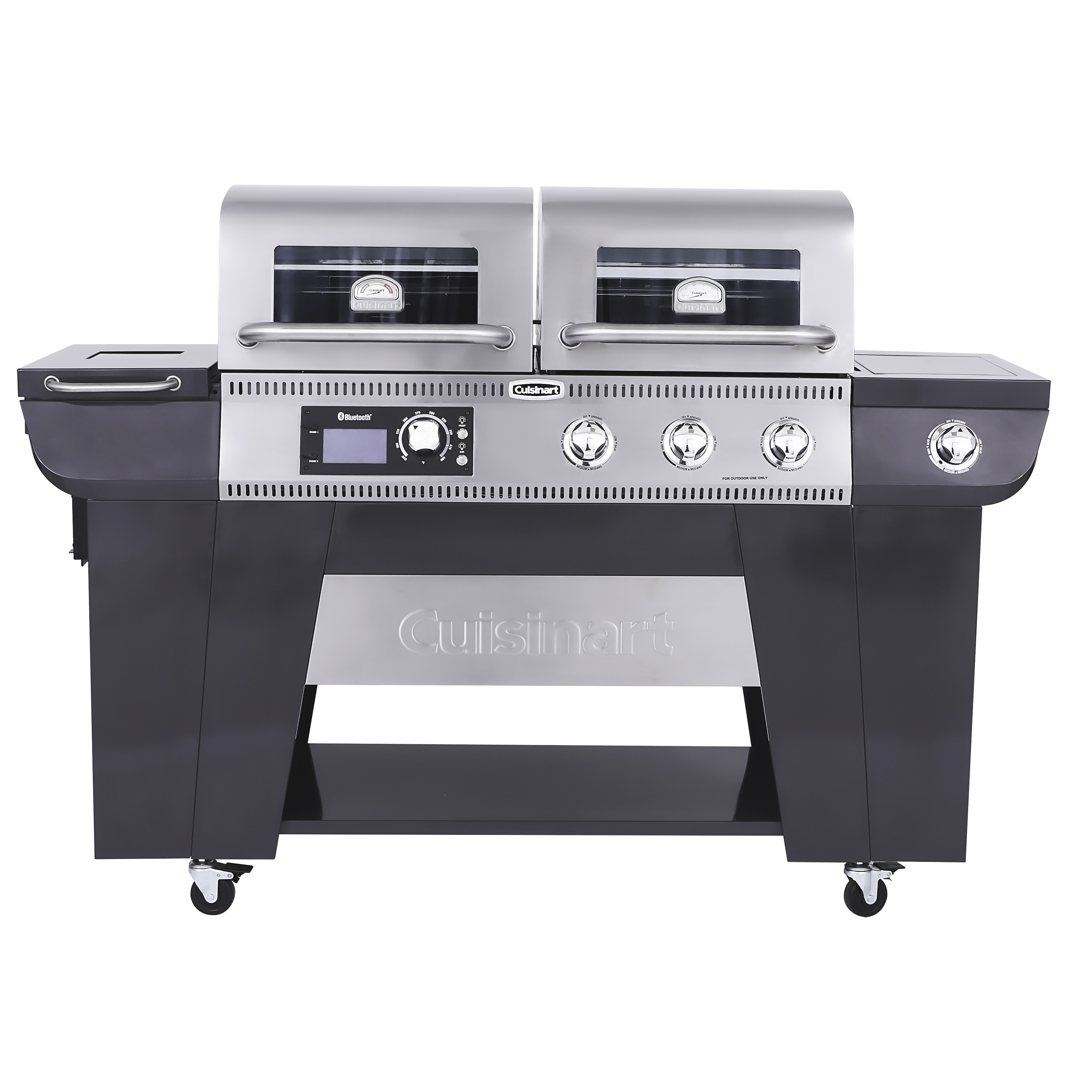

Slide 10


